Slide 1
Learning with Structured Data
Hanjun Dai
Nov 8, 2018

Slide 2
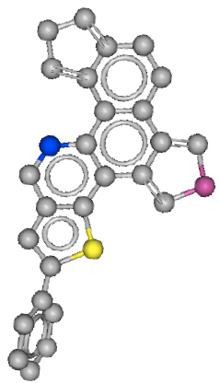
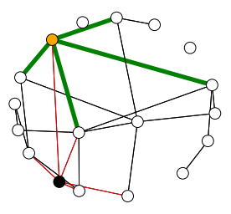
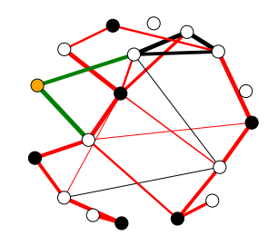
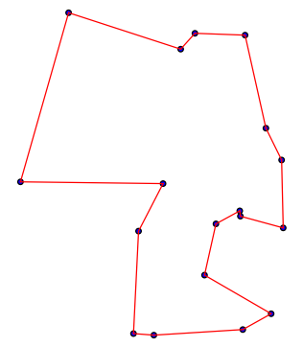
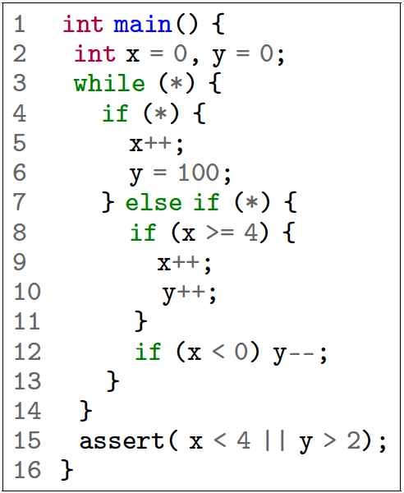
Applications of Structured Data
Vertex Cover
Maxcut
TSP
Molecule
discovery
Dai et.al, structure2vec, ICML 2016
Dai et.al, S2V-DQN, NIPS 2017
Knowledge Graph
Program
Verification
Zhang et.al, VRN, AAAI 2018
Xu et.al, code2vec, NIPS 2018

Slide 3
Outline
Representation Learning for Structured Data
Embedding graphical model inference algorithm
Extensions:
Kd-value prediction
Large scale graph embedding
Combinatorial Optimization over Structures
Learning to optimize NPC problems
Extensions:
Graph adversarial attack
Program verification

Slide 4








Part I: Representation Learning
Graph level
Node level
Representation
Learning
Edge level

Slide 5
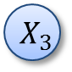


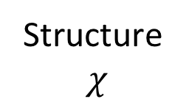



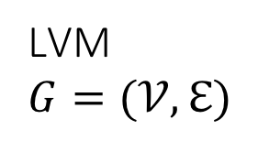
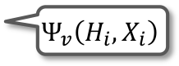
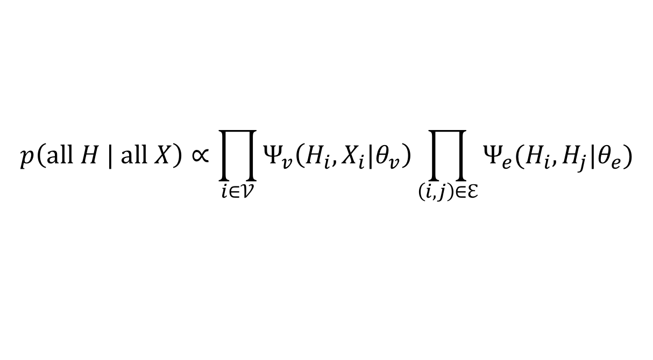
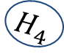


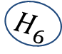
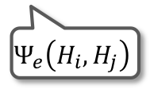

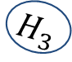






structure2vec—latent variable model
Structure
$χ$
$$H_{6}$$
LVM
$$G=(𝒱,ℇ)$$
$$X_{6}$$
$$X_{5}$$
Continuous
Latent
$$H_{5}$$
Represent
$$H_{1}$$
$$X_{6}$$
$$Ψ_{e}\left(H_{i},H_{j}\right)$$
$$X_{5}$$
$$X_{1}$$
$$X_{4}$$
$$H_{4}$$
$$X_{1}$$
$$H_{2}$$
$$H_{3}$$
$$X_{4}$$
$$X_{2}$$
$$X_{3}$$
$$Ψ_{v}\left(H_{i},X_{i}\right)$$
Categorical /
Continuous/
Raw features
$$X_{2}$$
$$X_{3}$$
Joint likelihood of hidden variables
$$p\left(all H | all X\right)∝\prod_{i∈𝒱}{Ψ_{v}\left(H_{i}, X_{i}|θ_{v}\right)\prod_{\left(i, j\right)∈ℇ}{Ψ_{e}(H_{i}, H_{j}|θ_{e})}}$$
Nonnegative node potential
Nonnegative edge potential
[Dai, Dai & Song 2016]

Slide 6
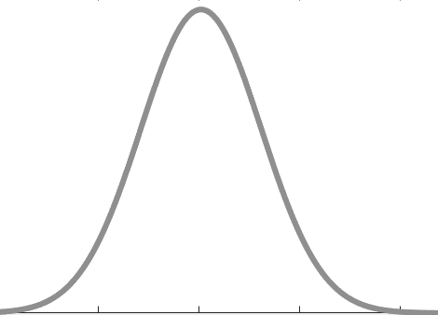
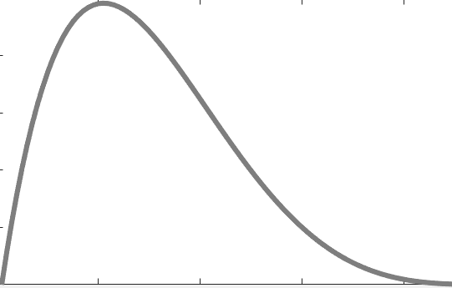
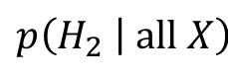
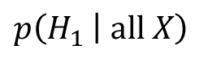
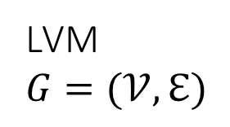
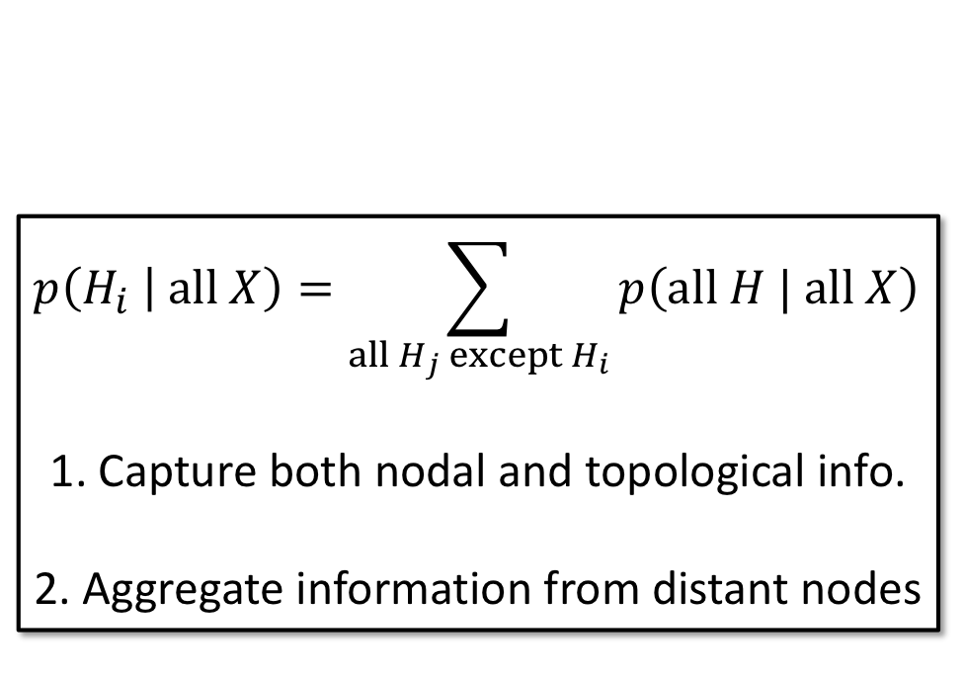
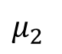
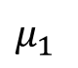
structure2vec—posterior as feature
$$μ_{1}$$
$$p\left(H_{1} | all X\right)$$
$$H_{6}$$
LVM
$$G=(𝒱,ℇ)$$
$$H_{5}$$
Statistics of posterior
$$H_{1}$$
$$X_{6}$$
$$X_{5}$$
$$μ_{2}$$
$$H_{4}$$
$$p\left(H_{2} | all X\right)$$
$$X_{1}$$
$$H_{2}$$
$$H_{3}$$
$$X_{4}$$
$$p\left(H_{i} | all X\right)=\sum_{all H_{j} except H_{i}}{p\left(all H | all X\right)}$$
1. Capture both nodal and topological info.
2. Aggregate information from distant nodes
$$X_{2}$$
$$X_{3}$$

Slide 7

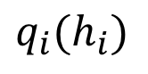




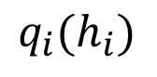


structure2vec—mean field inference
Variational distributions
$$q_{i}(h_{i})$$
Optimal solution satisfies the following fixed point equation:
Equivalently,
$$q_{i}(h_{i})$$
is the functional of neighbor marginals

Slide 8
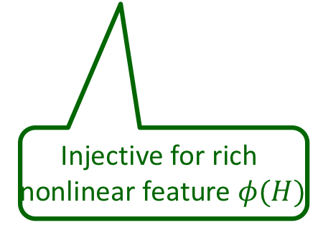
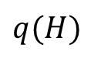
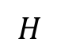
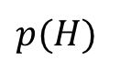
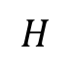
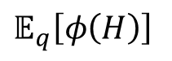
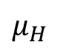
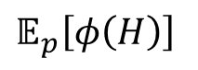
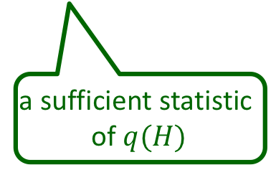
structure2vec--embedding
Density
space
$$p(H)$$
Feature
space
$$𝔼_{p}\left[φ\left(H\right)\right]$$
$$H$$
$$q(H)$$
$$𝔼_{q}\left[φ\left(H\right)\right]$$
$$μ_{H}$$
$$H$$
Injective for rich
nonlinear feature $φ(H)$
a sufficient statistic
of $q(H)$
[Smola, Gretton, Song & Scholkopf. 2007]

Slide 9
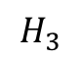
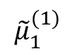
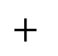
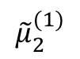
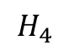
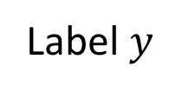
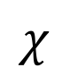
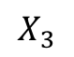
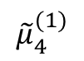
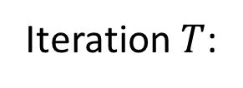
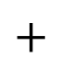
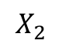
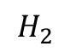
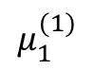
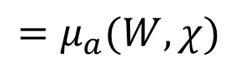
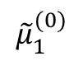
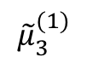















End to end learning
Iteration 1:
$$μ_{1}^{(1)}$$
$$μ_{2}^{(1)}$$
$$μ_{3}^{(1)}$$
……
$${\tilde{μ}}_{1}^{(1)}$$
$${\tilde{μ}}_{2}^{(1)}$$
$${\tilde{μ}}_{3}^{(1)}$$
$${\tilde{μ}}_{4}^{(1)}$$
……
Iteration $T$:
$$μ_{1}^{(T)}$$
$$μ_{2}^{(T)}$$
$$μ_{3}^{(T)}$$
……
$${\tilde{μ}}_{2}^{(0)}$$
$${\tilde{μ}}_{3}^{(0)}$$
$${\tilde{μ}}_{1}^{(0)}$$
$$H_{2}$$
$$H_{3}$$
classification/regression
with parameter $V$
Aggregate
P
$$X_{2}$$
C
$$H_{1}$$
$$X_{3}$$
$$H_{4}$$
$$μ_{1}^{(T)}$$
$${\tilde{μ}}_{4}^{(0)}$$
$$=μ_{a}(W,χ)$$
$$+$$
$$X_{1}$$
$$μ_{2}^{(T)}$$
C
$$X_{4}$$
N
$$+$$
Label $y$
$$χ$$
$$⋮$$

Slide 10



structure2vec—Loopy BP
Fixed point equation:
Function form:
One example of parameterization:

Slide 11

structure2vec experiments
Dataset | Harvard clean energy project
Size | 2.3 million
Avg node # | 28
Avg edge # | 33
 | Test MAE | Test RMSE | # parameters
Mean predictor | 1.986 | 2.406 | 1
WL level-3 | 0.143 | 0.204 | 1.6 m
WL level-6 | 0.096 | 0.137 | 1378 m
DE-MF | 0.091 | 0.125 | 0.1 m
DE-LBP | 0.085 | 0.117 | 0.1 m
Organic Solar Panel Materials
predict
Power Conversion Efficiency (PCE)
(0 -12 %)
[Dai et.al, ICML 2016]

Slide 12

structure2vec experiments
Molecule fragments
Effective ( > 10 ) | Ineffective ( < 0.5 )
[Dai et.al, ICML 2016]

Slide 13
Outline
Representation Learning for Structured Data
Embedding graphical model inference algorithm
Extensions:
Kd-value prediction
Large scale graph embedding
Combinatorial Optimization over Structures
Learning to optimize NPC problems
Extensions:
Graph adversarial attack
Program verification

Slide 14
Sequence2vec experiments
MAE
MITOMI 2.0
28 TFs
Regression problem
 | S2V | Cmp
RMSE | 0.035 | 0.039
PCC | 0.62 | 0.45
SCC | 0.29 | 0.26
MAE
Dai et.al, Bioinformatics 2017

Slide 15


sequence2vec interpretation
Sequence Motifs

Slide 16
Outline
Representation Learning for Structured Data
Embedding graphical model inference algorithm
Extensions:
Kd-value prediction
Large scale graph embedding
Combinatorial Optimization over Structures
Learning to optimize NPC problems
Extensions:
Graph adversarial attack
Program verification

Slide 17


Common strategies
Message-passing like operators
Problems:
Cost per update:
Harder to train for large T
-- which is needed here
Exponential growth
GCN, MPNN, GGNN, structure2vec, ...
T=1
T=2
>>Six degrees of separation

Slide 18


Optimization
Satisfying steady-state constraints

Slide 19


Inductive Experiments:
PageRank on Barabasi-Albert graphs
PPI: inductive

Slide 20
Outline
Representation Learning for Structured Data
Embedding graphical model inference algorithm
Extensions:
Kd-value prediction
Large scale graph embedding
Combinatorial Optimization over Structures
Learning to optimize NPC problems
Extensions:
Graph adversarial attack
Program verification

Slide 21



Learning graph opt: Motivation
Minimum vertex/set cover
Branch and Bound
Constructive Approximation
Exponential time complexity
Results too weak
Cannot learn from solved instances!

Slide 22
Learning graph opt: Motivation
Data from same / similar distribution
Social network: Barabási–Albert
Supervised learning?
No such supervision
Road network: fixed graph with
evolving edge weights
Reinforcement learning!
Learning by trial and error
Images taken from Wikipedia

Slide 23





Learning graph opt: RL background
Reward $R(t)$: score you earned at current step
State $S$: current screen
Action $i$: move your board left / right
Action value function $\hat{Q}(S, i)$:
your predicted future total rewards
Policy $π(s)$: How to choose your action
Greedy policy:
$$i^{∗}=argmax_{i} \hat{Q}(S, i)$$
[Minh, et al. Nature 2015]

Slide 24








Learning graph opt: RL on graphs
$$\min_{x_{i}∈\left\{0,1\right\}} \sum_{i∈𝓥}{x_{i}}$$
$$s.t. x_{i}+x_{j}≥1, ∀\left(i,j\right)∈𝓔$$
Reward: $r^{t}=−1$
State $S$:
current partial solution
Action value function $\hat{Q}(S, i)$:
Expected negative future loss
Greedy Policy $π(s)$:
Add best node
[Dai, et al. NIPS 2017]

Slide 25



Learning graph opt: action-value function
Parameterize Action value function $\hat{Q}(S, i)$ with structure2vec
Train with Deep Q-Learning (DQN)
Bellman optimality equation

Slide 26


Learning graph opt: quantitative comparison
A distribution of
scale free networks
Optimal approximated by
running CPLEX for 1 hour
approximation ratio $≈1$

Slide 27
Learning graph opt: quantitative comparison
Train on small graphs with
50-100 nodes
Generalize to not only graphs from same distribution
But also larger graphs
Approximation ratio < 1.007

Slide 28
Learning graph opt: time-solution tradeoff
Generate 200 Barabasi-Albert networks with 300 nodes
Let CPLEX produces 1st, 2nd, 3rd, 4th feasible solutions
CPLEX
1st
CPLEX
2nd
Embedding
produces algorithm
with good tradeoff !
2-approx
2-approx +
RNN
CPLEX
3rd
Embedded
MF
CPLEX
4th

Slide 29
Learning graph opt: real-world data
MemeTracker graph: 960 nodes and 5000 edges
Learning from sampled subgraphs
Methods | Approximation Ratio
Optimal | 1.00 ( 473 nodes)
S2V-DQN | 1.002 ( 474 nodes)
MVCApprox-Greedy | 1.222 (578 nodes)
MVCApprox | 1.408 (666 nodes)
http://snap.stanford.edu/netinf/#data

Slide 30

Learning graph opt: learned strategy
Learned a greedy algorithm which is different from known ones

Slide 31


Learning graph opt: other problems
Maximum cut
Traveling Salesman Problem
Set cover
Learn with
Bipartite graph
Solution found
optimal
Set cover image taken from Wikipedia

Slide 32
Outline
Representation Learning for Structured Data
Embedding graphical model inference algorithm
Extensions:
Kd-value prediction
Large scale graph embedding
Combinatorial Optimization over Structures
Learning to optimize NPC problems
Extensions:
Graph adversarial attack
Program verification

Slide 33
Attack: modifying graph structure
Attack by creating transaction
Transaction Network

Slide 34

















Attack using reinforcement learning
**solution: hierarchical decomposition (sequentially pick two nodes)
$$Q^{1∗}$$
$$μ_{v}^{(1)}$$
$$s_{t}$$
$$μ_{v}^{(K)}$$
$$W_{Q_{1}}^{(1, 2)}$$
……
$$a_{t}^{(1)}$$
$$μ_{u}^{(0)}$$
$$μ_{u}^{(K)}$$
S2V Module
$Q^{1∗}$value
$$\underset{a}{argmax}{Q^{1∗}}(s_{t}, a)$$
$$Q^{2∗}$$
$$a_{t}^{(2)}$$
$$s_{t+1}$$
$$W_{Q_{2}}^{(1, 2)}$$
……
$$a_{t}$$
$$\underset{a}{argmax}{Q^{2∗}}(s_{t}, a_{t}^{\left(1\right)},a)$$
S2V
$Q^{2∗}$value

Slide 35


Experiments
Synthetic:
Classify # components
In a graph
Real-world:
Node classification

Slide 36

Experiments
Attack solution proposed by RL, which connects two distant nodes
**finding: the existing graph neural nets are not efficient
at capturing long range information.

Slide 37
Outline
Representation Learning for Structured Data
Embedding graphical model inference algorithm
Extensions:
Kd-value prediction
Large scale graph embedding
Combinatorial Optimization over Structures
Learning to optimize NPC problems
Extensions:
Graph adversarial attack
Program verification

Slide 38


Learning Loop Invariant
Highly sparse reward ---- 1 on correct proposal, and 0 for others
Key observation:
Using counter examples to smooth the trial-and-error procedure

Slide 39

Learning Loop Invariant
Better sample complexity

Slide 40
Q&A

